Slide 1
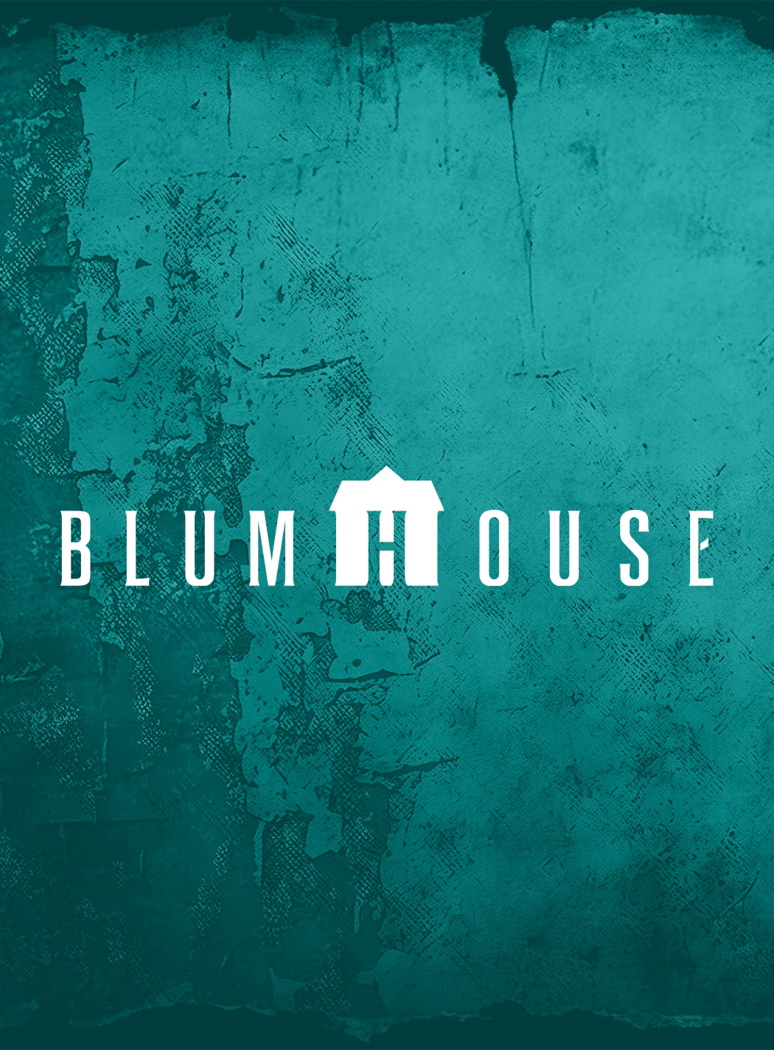
Blumhouse Brand Audit
Prepared by Patrick Regan

Slide 2
Managers understand what the brand means to consumers. (6)
The brand has demonstrated a clear understanding of the desires and tastes of its target audience in the past, but has suffered several high-profile missteps in the past few years, including one that the CEO directly attributed to misunderstanding the audience, indicating their mental maps may be faulty.
The brand mantra for Blumhouse is “Horror isn’t one thing”, which also serves as a tagline. This mantra allows them to cover a lot of bases, while also communicating to their audience that they understand horror fans are not a monolith.
The customer-driven boundaries are fairly flexible, given the brand’s established genre output and the wide range that genre can cover. However, the aforementioned failure indicates they may need to take a moment to reassess where those boundaries are.
Notes:
The failure in question is M3gan 2.0, the 2025 sequel to 2022’s smash hit M3gan. Most estimates suggest that the film lost money after accounting for the marketing spend and theater split and may have wrecked a promising brand ambassador in the character of Megan.
Jason Blum himself admitted this failure was due to misunderstanding what the audience wanted with Megan, saying, “We all thought M3GAN was like Superman. We could do anything to her. We could change genres. We could put her in the summer. We could make her look different. We could turn her from a bad guy into a good guy. And we kind of classically over thought how powerful people’s engagement was really with her.”

Slide 3
The brand is properly positioned (7)
By focusing on quality and taking multiple small bets on movies with controlled budgets, Blumhouse was able to quickly amass several popular franchises, creating strong points of parity (PoP) with other storied horror houses.
Ironically, Blumhouse’s former point of differentiation (PoD) has become a PoP. Most of their competitors take a similar ethos, and some have a strong PoD of their own (A24’s arthouse horror). This comes at a time when Blumhouse’s stable of franchises is growing stale; it would do well to re-commit to its small bets strategy, as it did with Obsession.
Notes:
The most notable competitor in this space is A24, which has built its own brand identity, but Neon and Shudder are both moving in as well. In essence, Blumhouse has a lot going for it, but risks becoming that most typical of stories – the underdog who becomes the establishment, vulnerable to the next underdog.

Slide 4
Customers receive superior delivery of the benefits they value most (8)
Blumhouse is attempting to uncover unmet consumer needs by taking small bets on young filmmakers with Obsession and Backrooms (through their subsidiary Atomic Monster). Both hit big and pulled the Gen Z market back into theaters, following up on the Gen Z favorite Five Nights at Freddy’s franchise.
Blumhouse is known for producing films with small budgets, but all that money clearly ends up on the screen. These are low-budget horror movies; they aren’t cheap horror movies. They live or die by the talent behind them, not splashy effects, but they never lack for polish.
Notes:
To give them credit, they seem to have learned from the failure of M3gan 2.0. They acknowledge they really misunderstood what went wrong and have had several other major successes targeting the Gen Z audience. However, given the timeline of filmmaking, those movies were already in the pipeline when M3gan 2.0 went bust, so it remains to be seen if they’ll continue on this path.

Slide 5
The brand takes advantage of the full repertoire of branding and marketing activities available to build brand equity (10)
The brand’s name, logo, and title card (essentially an animated logo that plays before the movies) are all strategically designed together to build awareness. Jason Blum himself often acts as a spokesman for horror, and they frequently have two mazes at Universal’s Halloween Horror Nights event, with the studio name prominently featured. Most audience members couldn’t identify the production company of anything they watched, but Blumhouse is an exception.
The brand primarily relies on pull strategies to get audiences into theaters and purchase merchandise, as push marketing is mostly handled by their distribution partners (mostly Universal, but occasionally Warner Bros. and, in one interesting recent case, A24 itself). Additionally, their distribution partners are also a part of the pull marketing campaign, such as Universal selling Blumhouse merch in their theme parks.
Notes:
It’s worth noting that there is some push marketing, inasmuch as how Blumhouse sells their movies to distributors. However, that’s a very complex, very different set of marketing initiatives, and are also tied up in Blumhouse’s first look deal with Universal. Basically, Universal gets the first look and chance to distribute for any film Blumhouse makes before being shopped around. They almost always accept.
There is a slight exception for Blumhouse’s subsidiary brand, Atomic Monster, which has done a few movies for hire for Warner Bros., but that again falls under complex legal wrangling that is beyond the scope of this audit.

Slide 6
Marketing and communications efforts are seamlessly integrated. The brand speaks with one voice. (8)
The brand has clearly thought of all the ways it could create brand awareness. Event marketing, permission marketing, social media, PR, and promotions, it’s hard to find a place Blumhouse isn’t.
The brand could be more aggressive in promoting its “Horror isn’t one thing” mantra. Partially, this is because every film has to be marketed as its own mini-brand, which doesn’t leave much room to push the brand itself, but it could do things like sponsor a horror convention to promote inclusiveness in the fandom.
Blumhouse is excellent at capitalizing on the unique capabilities of every communications option. Working with their distribution partners gives them access to a sophisticated understanding of how to get the most out of every option.
Blumhouse could be better at preserving important brand values. Some of that rebellious spirit has been lost as they’ve become the horror establishment and are relying on sequels and franchises. Luckily, recent successes seem to indicate a turnaround.
The brand is excellent at leveraging social and digital channels. Their Instagram is always covered in their newest hits, upcoming movies, and fun shareable content (such as their choice memes). Their “Get in the Van” newsletter acts as excellent email and permission marketing, letting them communicate directly with fans and marketing sneak peeks so they become brand evangelists.
The brand does not utilize mobile marketing, but there’s no strong way to do so. The best way to use mobile marketing on a film would be to detect proximity to the theater, but that’s the purview of the movie theater chains themselves, who might not like the other companies invading their “turf”.
Notes:
In particular, movie theater chains would balk at anything that implies one chain was superior to another. Given that people don’t normally go to the movies on impulse any longer, the juice is simply not worth the squeeze for mobile marketing. Hence, it didn’t affect their score – they’re making the right choice to not bother.
I do think they could push their brand a little more aggressively, although I think this comes from two elements.
Complacency. They’ve been the biggest game in town for a while and are only now calibrating to having competition.
Cultural reasons. Production companies are not used to thinking of themselves as a public-facing brand. Blumhouse embraces it more than most, but it’s still a hard mindset to shake.

Slide 7
The brand’s pricing strategy is based on consumer perception of value. (10, N/A).
Production companies, by and large, do not set pricing for their films. Blumhouse operates a small merch shop, but the pricing is fairly uniform and likely set to match the pricing of other retailers (Universal Parks for shirts, theater chains for popcorn buckets, etc).
Additionally, their fees with the distributors are largely based on pre-negotiated, industry-standard rates and formulas.
Notes:
Pricing for the brand’s primary product (movies) is set by the exhibitors (the streamers and the movie theaters) according to a standard formula. Within the theater itself, you might pay a premium for a nicer screen, but two movies exhibited on the same screen will have the same price.
In essence, there are simply no real opportunities for Blumhouse to execute a pricing strategy beyond accepted industry standards. Therefore, I gave it a 10, because it’s doing everything it can do in this regard, but the more accurate answer is N/A. There’s no room for a pricing strategy in this category, at least for the production company.

Slide 8
The brand uses appropriate imagery to support its personality (9)
Blumhouse has established strong credibility that it, and the people behind it, are considered trustworthy experts. CEO Jason Blum has been a key part of that – he’s not afraid to give interviews or show off his bona fides as a horror fan. To the audience, he’s “one of us”. His candor regarding M3gan 2.0’s failure and the reasons for it was vital in preserving brand trust after what could have been a disaster.
Blumhouse’s logo and title card are immediately recognizable and act as a fantastic identifier for the brand and their “Horror isn’t one thing” mantra. Their “The Van” newsletter ties into this, offering a customizable van logo based on their favorite film that users can share on social media.
Blumhouse’s brand personality is overtly tied to that of its namesake, Jason Blum. He’s a huge classic horror fan, and his love for all things spooky is seen in every aspect of Blumhouse’s imagery. This is most obvious in their title card, which acts as a kind of “ghost tour” of all the kinds of horror you can find in Jason Blum’s haunted house. His Blumhouse, if you will.
Notes:
A quick descriptor of the title card: The camera pulls back from a haunted forest through a haunted house, taking the viewer through a menagerie of monsters and killers in a horror film style. It then emerges from the front to reveal the logo. It implies all these monsters are in the Blumhouse house, and the viewer will experience that fear alongside them.
The variety of monsters supports their “Horror isn’t just one thing” motto and suggests that there’s something for everyone in Blumhouse. A particularly clever move is that none of the monsters in the title card are any of their iconic terrors, which would run the risk of being too restrictive. There’s only one exception – the first monster is Michael Myers of Halloween, the original monster of modern horror. This reminds the audience that Blumhouse is the current steward of the franchise, the most beloved and storied horror property there is.

Slide 9
The brand is innovative and relevant (7)
Blumhouse is heavily investing in Gen Z filmmakers who made their bones on YouTube, sometimes adapting major horror franchises to the big screen. This shows a forward-thinking marketing and product investment in where horror is going, not just where it has been. It’s also a relief, as Blumhouse had started to be known for several major franchises that were clearly growing stale.
The brand is clearly executing a pivot after badly misreading the moment with M3gan 2.0. That film, followed by a series of disappointing releases, indicated they might be growing out of touch, but their small bets on young filmmakers are starting to pay off.
Notes:
If I had turned this report in two weeks ago, this grade would have been much lower. For all that Blumhouse’s recent successes, they were leaning heavily on established franchises and adaptations of existing horror properties with their own audiences. They were in very real danger of becoming the Disney of horror – more focused on IP management than actual innovation.
However, Obsession came out two weeks ago and is on track to do Five Nights at Freddy’s numbers. It’s only real competition, Backrooms, is actually produced by a Blumhouse subsidiary. By taking a chance on a YouTuber with an interesting story to tell, Blumhouse broke out in a big way, and they would benefit from continuing to look for new talent with interesting stories to tell. This raised their score, but for it to get up higher, they’ll have to follow through on their recent success.

Slide 10
The brand architecture is strategically sound (7)
If one considers every franchise (The Conjuring, Insidious, Black Phone, etc) as a mini-brand, then they all benefit from the brand association halo of Blumhouse’s reputation for quality and an expansive view of horror. In essence, this is a strong brand house strategy. Some of the sub-brands could be a little more well-differentiated, as they are starting to have a notable type (and several shared actors), but recent films have been more strongly differentiated.
Blumhouse has only one true subsidiary, production company Atomic Monster. Atomic Monster is technically owned by Blumhouse and produces many of Blumhouse’s franchise movies for it, but it also produces movies like Backrooms for A24 or even the Mortal Kombat movies for Warner Bros. The relationship between the two companies is, to be honest, somewhat confusing and could be operated a little more strategically. However, this is likely also more about the personal relationship between Jason Blum and Atomic Monster head and Blum protege James Wan.
Notes:
Atomic Monster’s relationship with Blumhouse is very confusing, and there’s likely some behind-the-scenes elements we’re not privy to. In particular, Atomic Monster producing the Backrooms, which was then distributed by competitor A24, is VERY interesting. However, again, it’s unlikely there’s too much strategic thought here – it’s more likely just an effect of the personal relationship between the two producers and a desire to take advantage of each other’s resources and opportunities.

Slide 11
The brand has a system in place to monitor brand equity and performance (5)
Blumhouse could absolutely benefit from creating a brand charter, especially as it faces down meaningful competition and the need to define itself beyond being the old man in the race.
There’s no evidence of whether the brand conducts regular audits. It would do well to do so. However, given the slow pace of film production, it would be better to space them out over years, rather than quarters.
It is unlikely the brand conducts routine tracking studies, as this tends to be handled at the distributor level for production companies.
It’s unknown whether the brand is distributing brand equity reports, but it absolutely should if it is not. Blumhouse is one of the few production companies with an actual brand – that’s an incredibly valuable asset and shouldn’t be treated lightly.
While there is a brand director, the role is combined with social media and staffed by a more junior marketer. This would indicate that brand equity is not a high focus for the brand. While it might not require an experienced brand pro, it would be smart to separate the two roles. Social media marketing is enough work for an active company like Blumhouse; someone else should give the brand the attention it deserves, even if it’s an occasional freelancer to conduct audits.
Notes:
This is probably the biggest area of concern for the studio. Few production companies have established “Brands”, and they can rely on Universal to do a lot of heavy lifting for them, so it’s understandable why they aren’t focusing too much on their brand reputation.
However, given the messy failure of M3gan 2.0 and the unexpected triumph of Obsession, it would benefit the studio to take its brand a little more seriously. It’s easy in moments like that to assume “Oh, everything is fine, we’ve got it under control”, but that’s often when things are their most dangerous.

